Slide 1
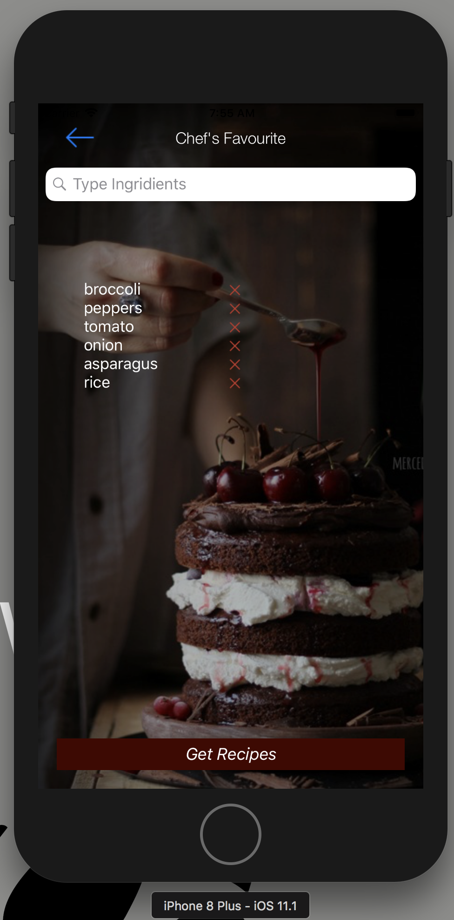
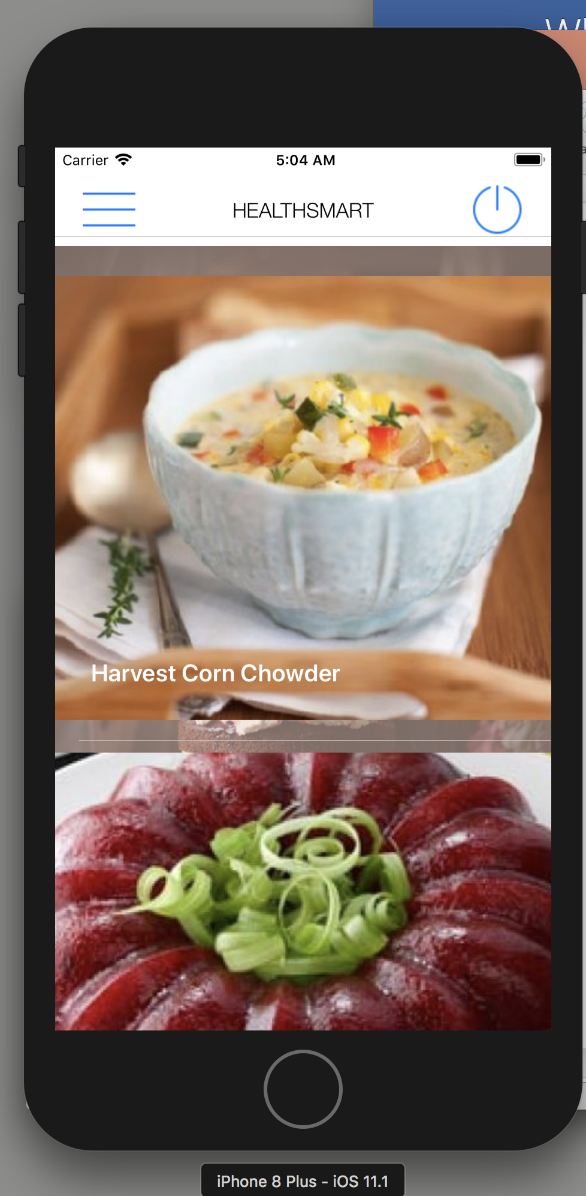
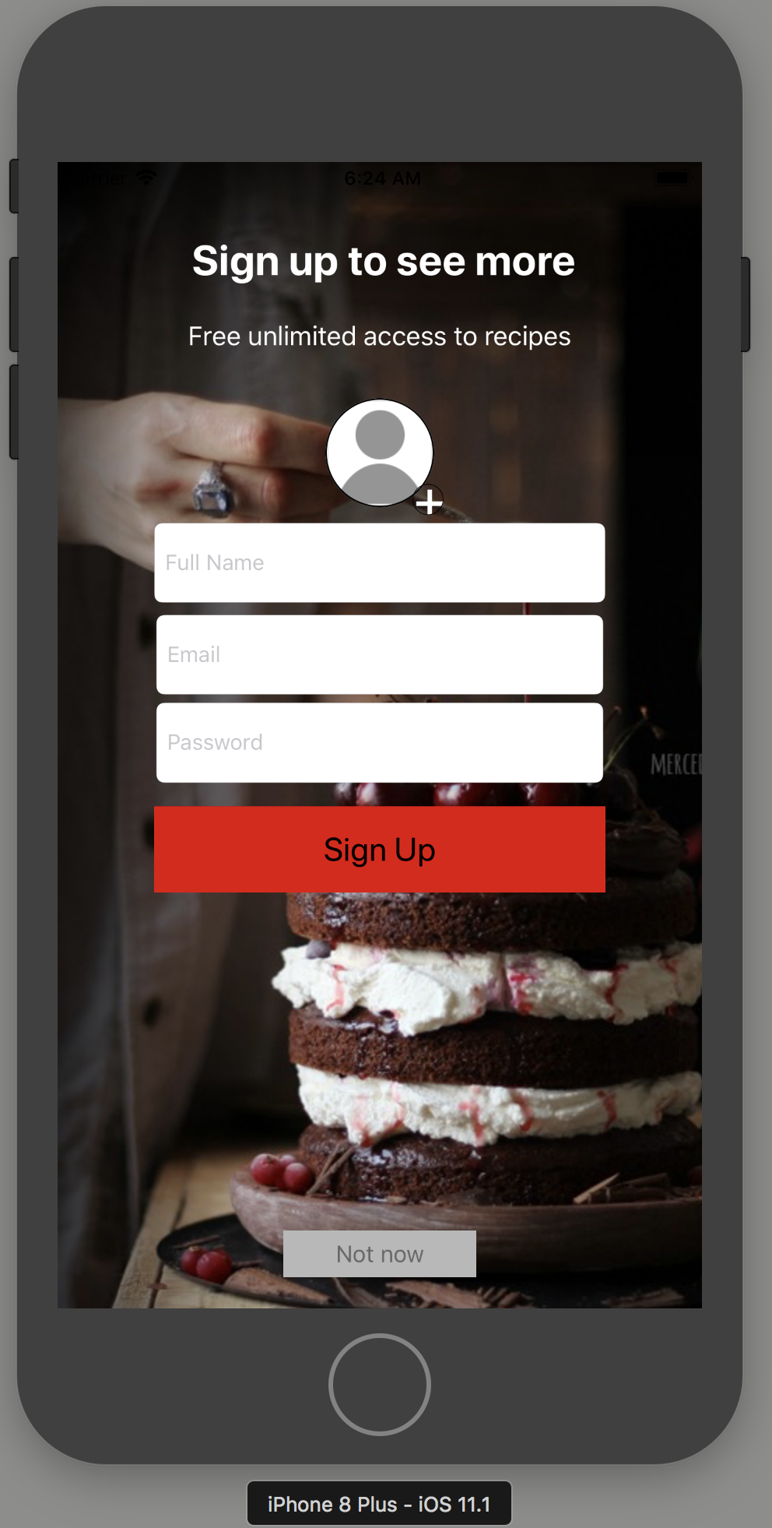
HealthSmart
Apoorva Lakhmani
Nirali Merchant
Notes:
NOTE: To replace a picture, just select and delete it. Then use the Insert Picture icon to replace it with one of your own!

Slide 2
HealthSmart
Introduction
Object Model
Design
Snap shots
Future Enhancements

Slide 3
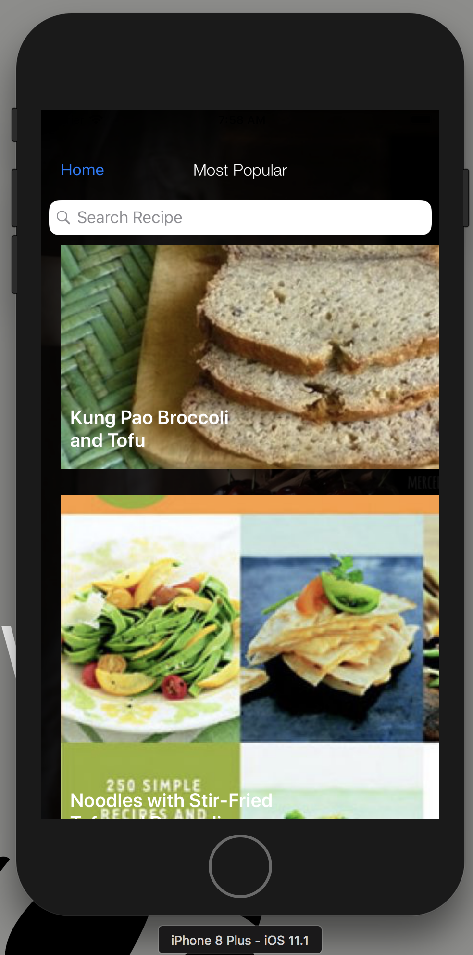
Introduction
Many people these days find it difficult to manage their time as well as health in an organized way. One or the other gets compromised where in people either end up wasting a lot of time in cooking food which may or may not taste good or starving which will in turn affect their health.
There is no application which provides an end to end functionality for the management of daily food, health and time management.
This app is an effort to solve two of the most important things which are required to maintain a healthy and balanced life.
This can be solved by saving time by giving recipe options based on the ingredients, store options to shop grocery, manage favorite recipes, prepare a meal planner and have an ideal cooking experience all through a single app

Slide 4
Detailed Specifications
Sign up and Login using your personal email ID or login through Facebook
View Recipe Details(Ingredients, Preparation Time, Likes, Preparation Steps)
Export the ingredients list for multiple recipes and get suggestions and directions of nearby grocery stores
Search Recipes that can be made using the ingredients you have at hand
Watch Youtube video of the recipe
Favorite the recipes you like
Share the recipe
Timer mode to get an ideal cooking experience.

Slide 5
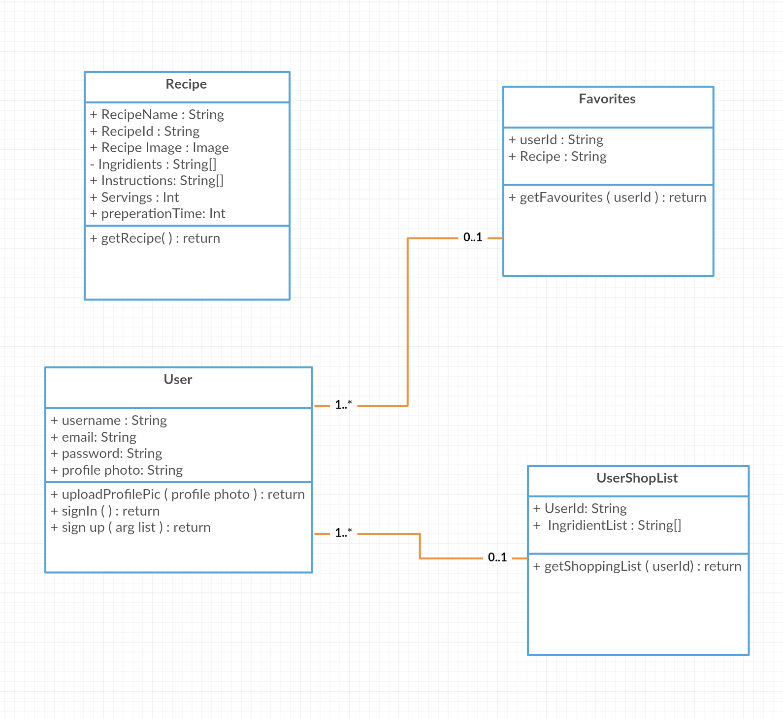
Object Model

Slide 6
Design
Firebase Authentication, Storage and Database
Facebook SignIn
Apple Maps
Youtube video
Timer
AVFoundation

Slide 7
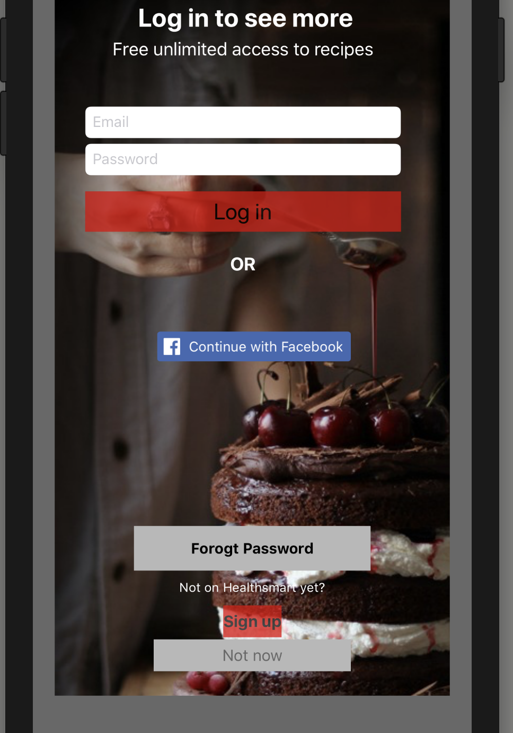
Snapshots

Slide 8
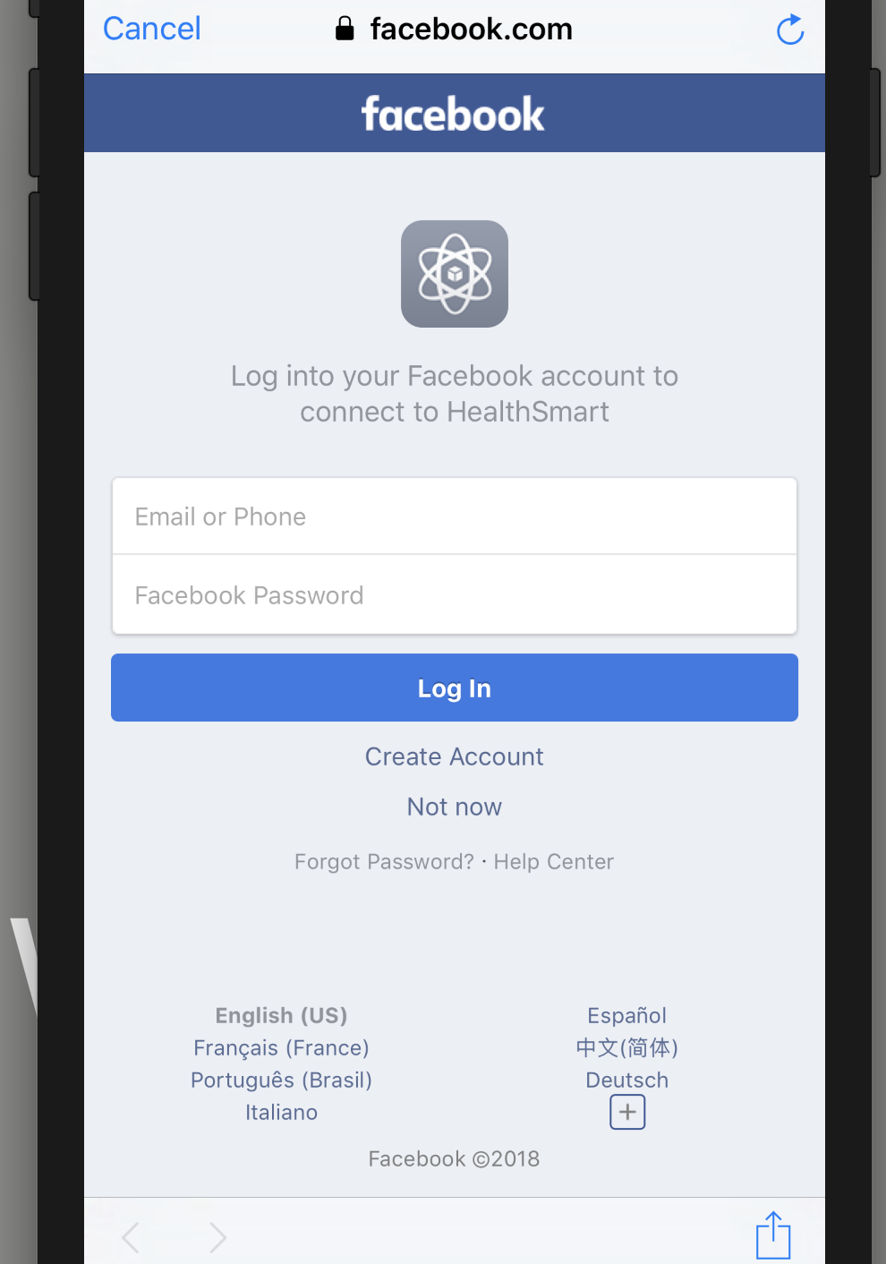
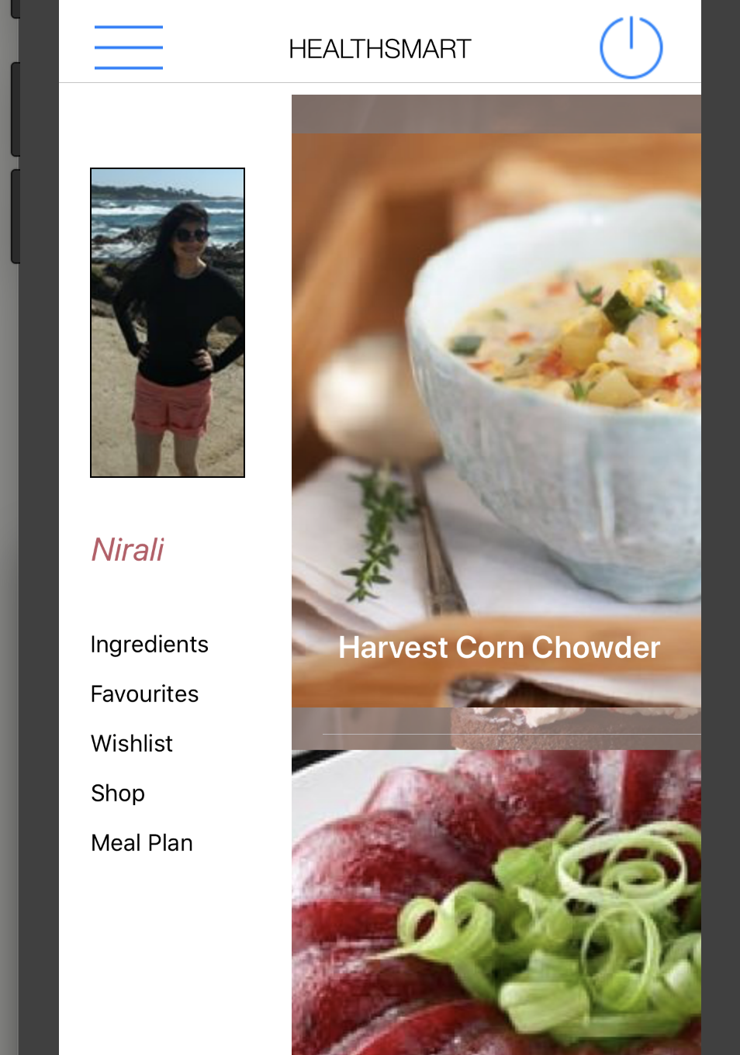
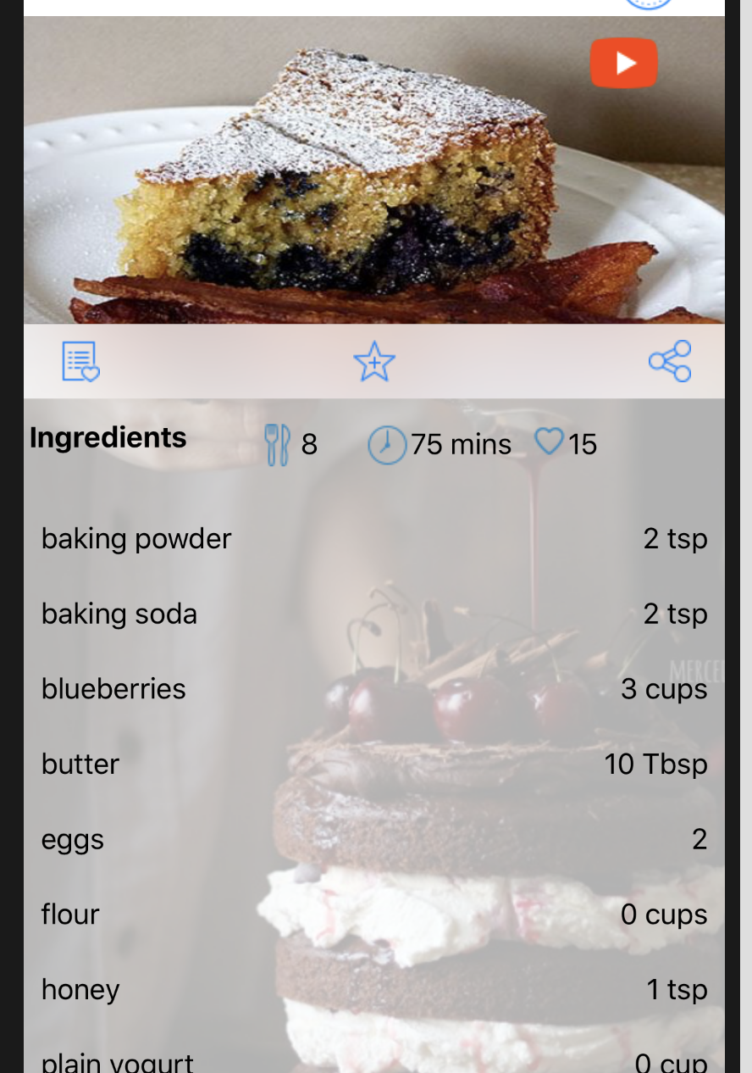
Snapshots

Slide 9
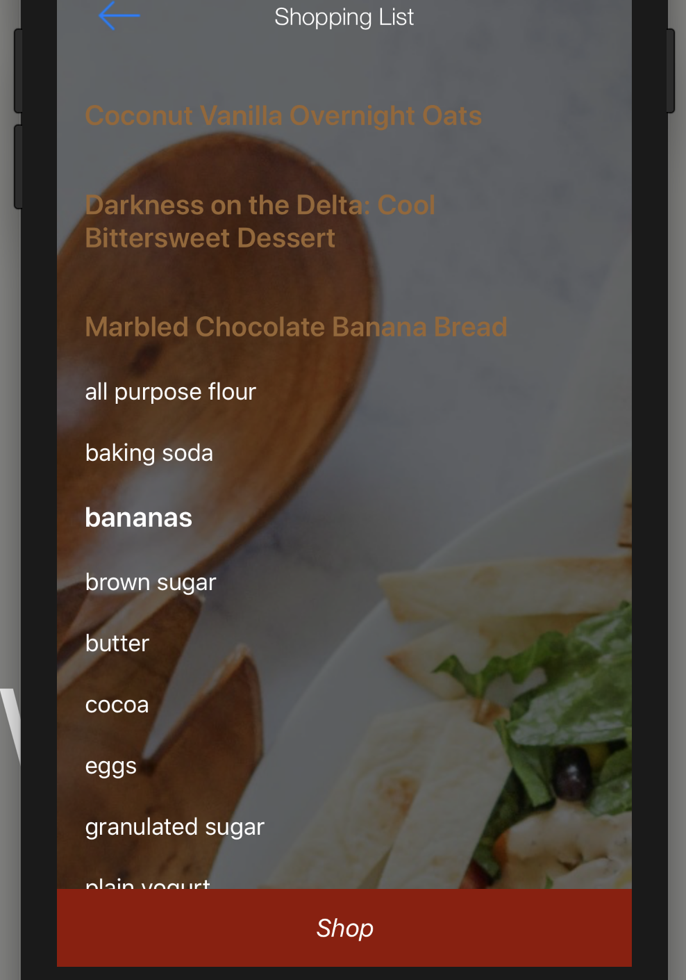
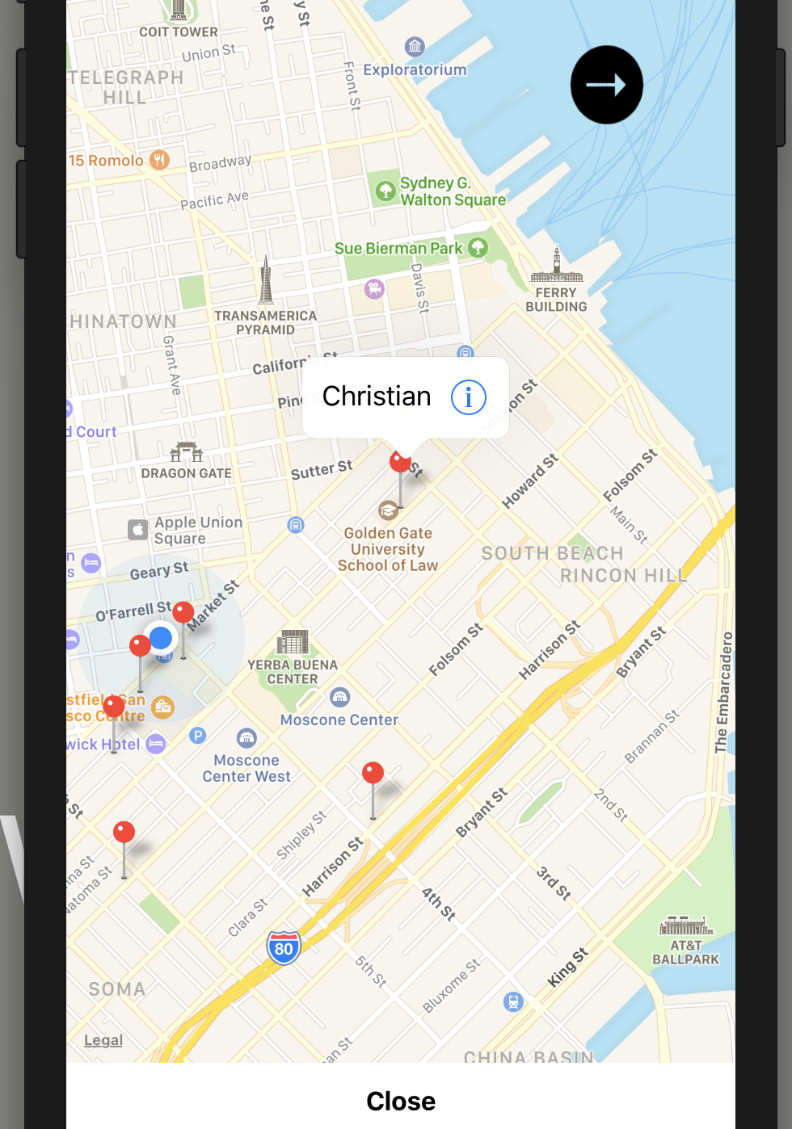
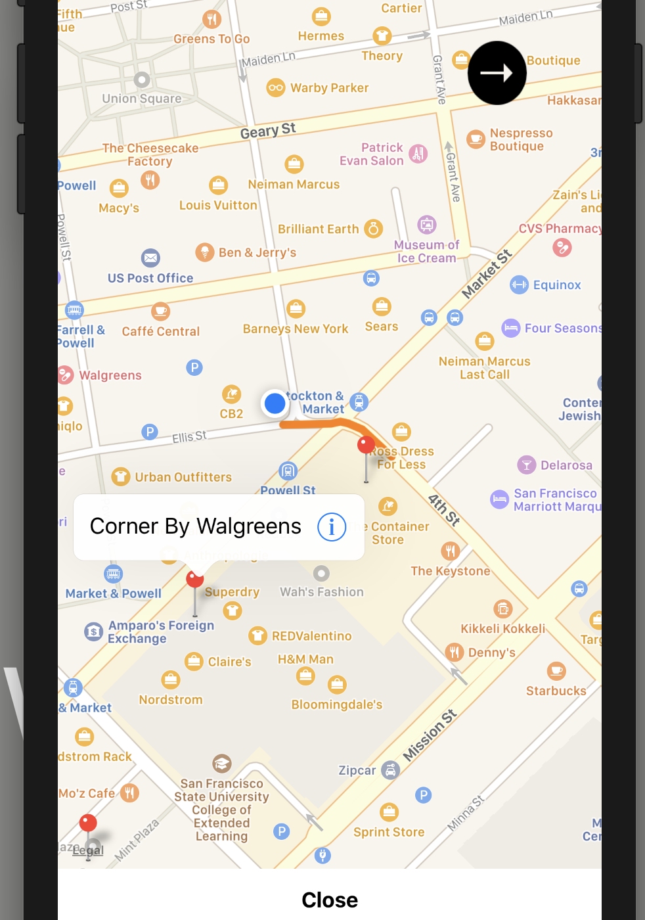
Snapshots

Slide 10
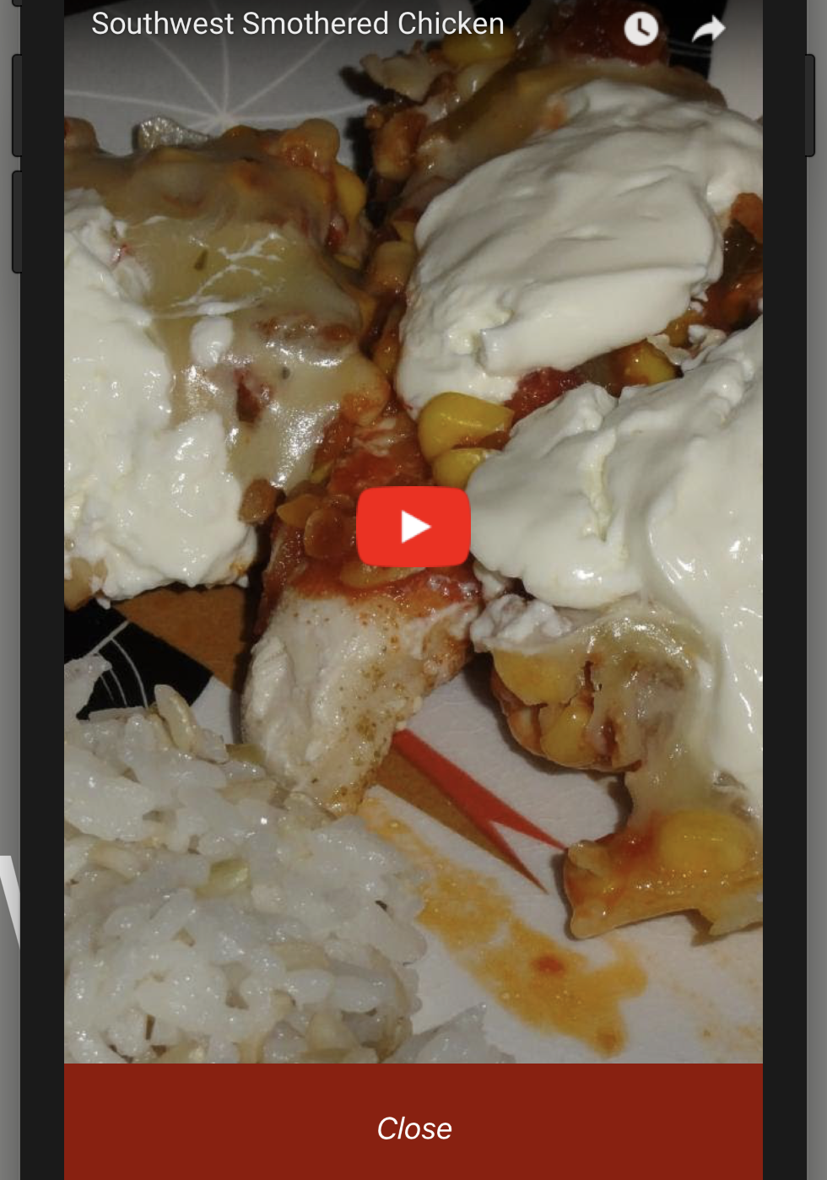
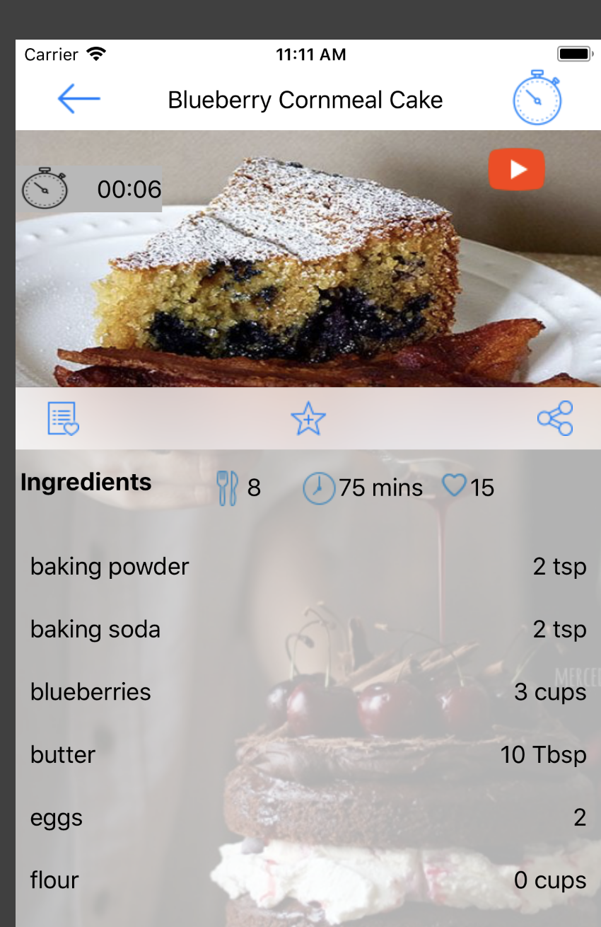
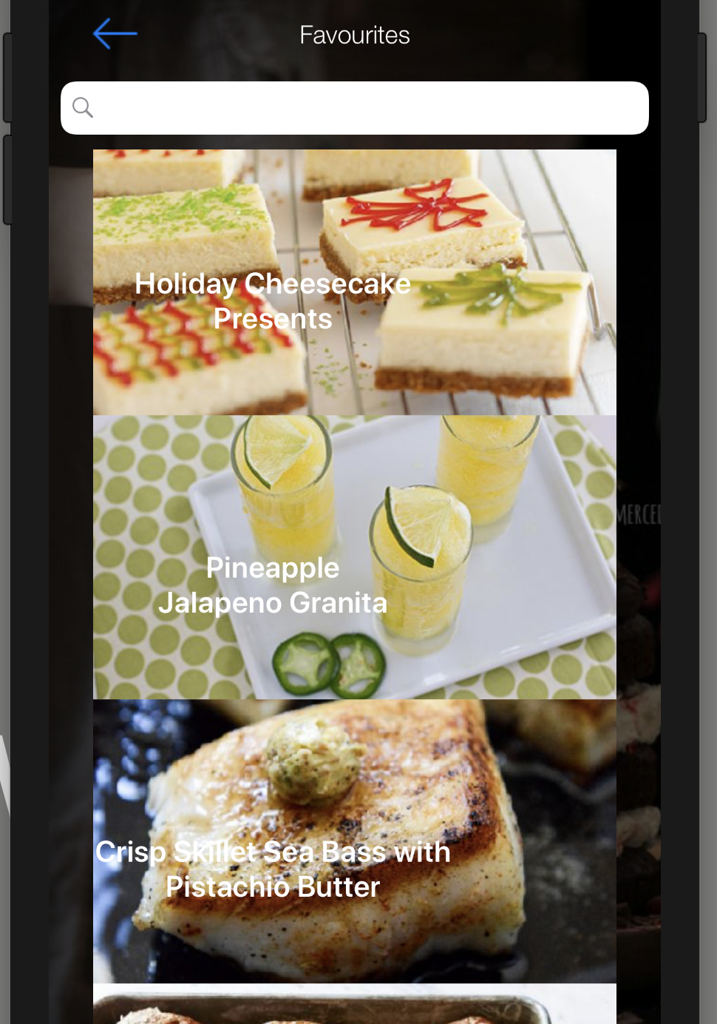
Snapshots

Slide 11
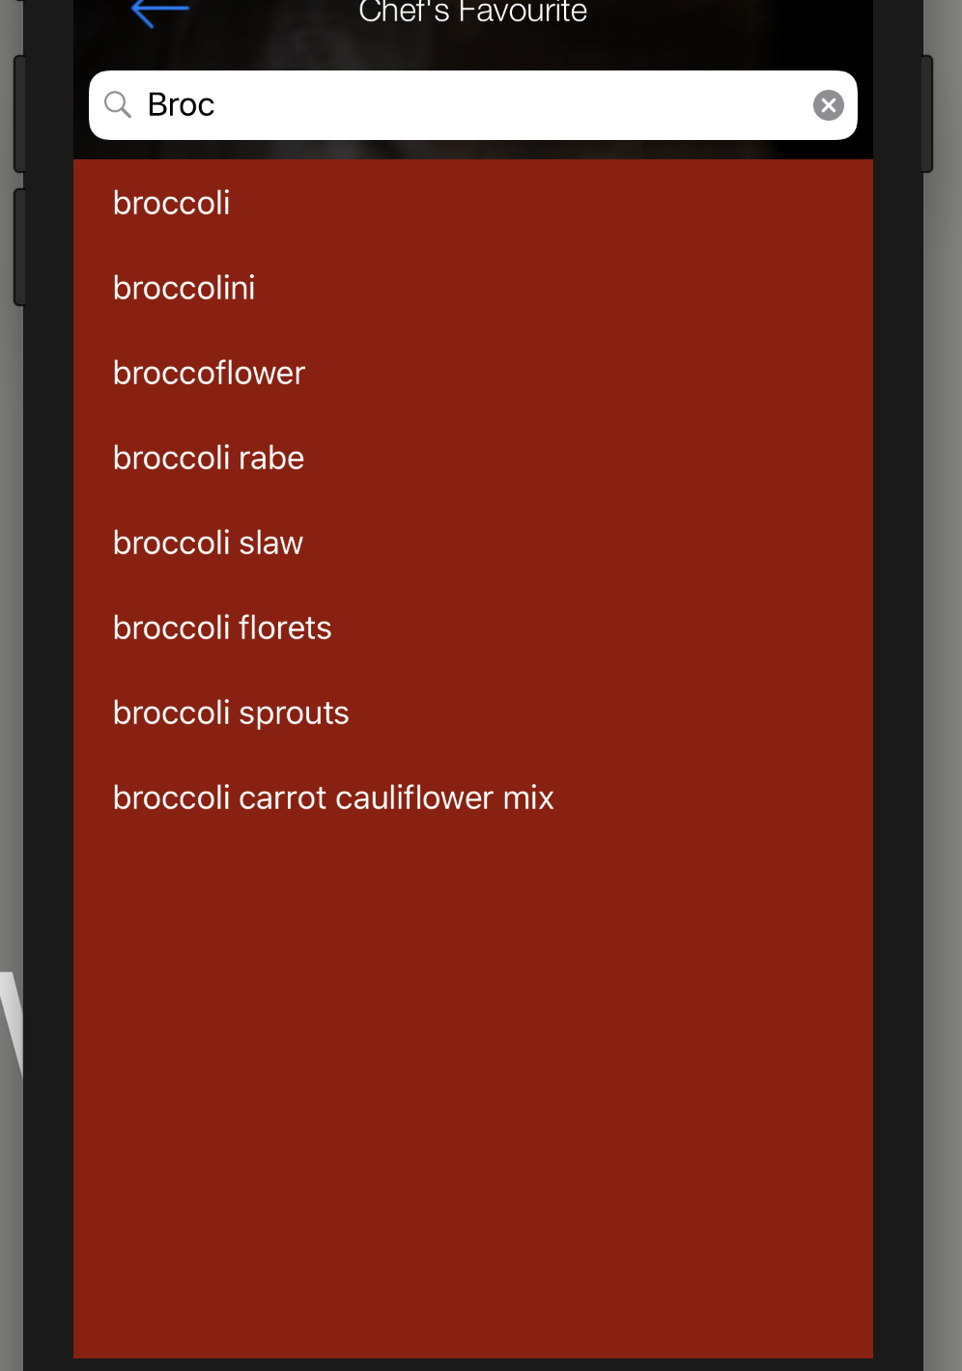
Snapshots

Slide 12
Future Scope
Meal Planner
Activity Notifications
Filter Recipes
Discussion Forum
Calorie Manager
Hands Free Cooking

